Slide 1
Game theory and strategic interaction Normative conflict
Prof. Dr. Heiko Rauhut
University of Zurich, Institute of Sociology
30.4.2019
Notes:
One of the most fundamental questions in the social sciences is the following:
How does cooperation come about?
One essential condition for the emergence of cooperation is that actors are willing to restrict their self-interest in order to contribute to collective goods. My interest in this debate is how social norms promote cooperation.
This is not as easy as you may expect. It is often the case that people are willing to adhere to norms of cooperation. However, people often have different opinions, what they regard as just, fair and appropriate.

Slide 2
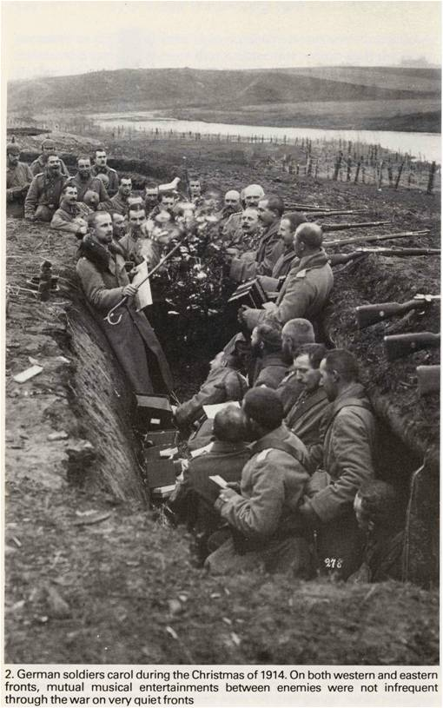
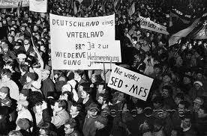
Classical perspective: social norms generate cooperation
social norm: shared expectation about restricting self interest; sanctioned
Non-aggression norms in world war I (Axelrod 1984, Ashworth 1980)
Norms of civic duty and voter turnout Green & Shapiro 1994, Knack 1992, Gerber, Green & Larimer 2008
Norms of political participa-tion and Monday demon-strations, GDR, 1989 Jasso & Opp, 1997
Fairness norms und emergence of cooperation Ostrom, Walker & Gardner 1992; Fehr & Gächter 2000

Slide 3
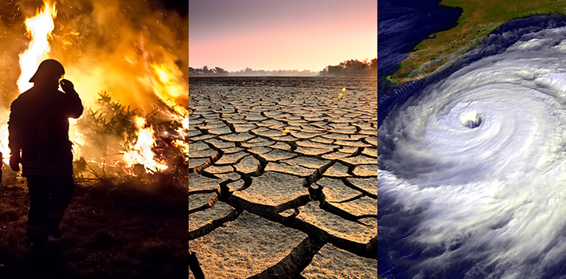
Normative conflicts
Conflicting cooperation norms in environmentalism
Environmental contribution norms:
heavy contaminators largest contributions or all same contributions?

Slide 4
Normative conflicts
Conflicting distribution norms of donated organ allocations
Gross & Kriwy: Einstellungen zu einer gerechten Organallokation. Das Gesundheitswesen 70, 2008: 541-549.

Slide 5
Normative conflicts
Conflicting distribution norms of donated organ allocations
Waiting list (equality norm)
Healthy non-smokers first (equity norm)
Gross & Kriwy: Einstellungen zu einer gerechten Organallokation. Das Gesundheitswesen 70, 2008: 541-549.

Slide 6
Normative conflicts
Consumption norms: Vegan vs. meat

Slide 7
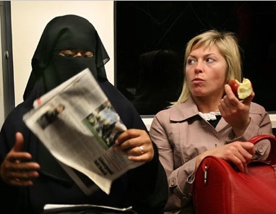
Normative conflicts
Gender norms how to dress in public

Slide 8
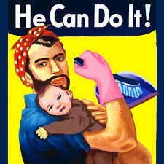
Normative conflicts
Gender norms about fair division of labor in the household

Slide 9
Normative conflicts
Exemplary case study
Conflicting norms of the “right” climbing style
Technical climbing, using all means (e.g. Eiger Japanese Diretissima, (route 6))
Free climbing, using rope only for protection (e.g. A. Ondra, The Change)
Free solo, using no protection (e.g. W. Güllich, Separate Reality)
Notes:
Ondra, the change
Güllich, separate reality

Slide 10
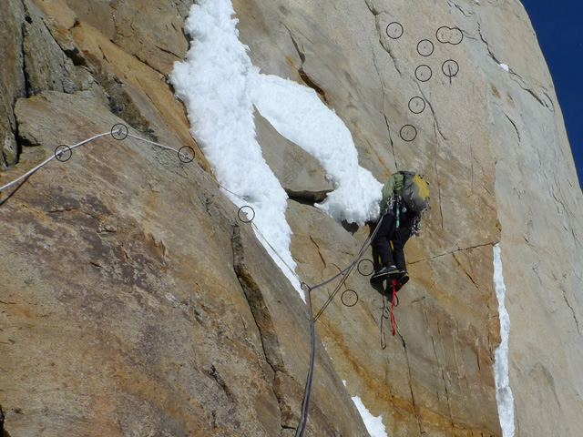
Normative conflicts
“Altruistic” efforts to enforce the “right” climbing style
„Kompressor route“, Cerro Torre: Removing 125 bolts to make the route more dangerous (!), harder, but back to the „right“ style. „Climbing war“ with lynching attempts
First free ascent by David Lama (→ the „right“ style)
http://blog.tagesanzeiger.ch/outdoor/index.php/16542/zwei-jungkletterer-spalten-die-alpinistengemeide/
Notes:
Ondra, the change
Güllich, separate reality

Slide 11
Normative conflicts
Exemplary case study
Everest climbing: Tourism vs. extreme sports
http://www.spiegel.de/reise/fernweh/schlaegerei-am-mount-everest-ueli-steck-im-interview-a-899357.html
http://www.srf.ch/news/panorama/die-schattenseiten-des-kommerzes-am-everest
Notes:
Ueli Steck and Simone Moro in Shepa attacks
«Motherfucker, what are you doing?» Dieses Schimpfwort auf 7100 Meter brachte das Fass zum Überlaufen. Auf den verbalen Streit am Berg folgte im Camp 2 eine handfeste Auseinandersetzung. Ueli Steck wurde tätlich angegriffen und mit Steinen beworfen. «Man wollte uns umbringen, die Sherpas wollten Blut sehen» sagt Steck gestern im Interview mit «10vor10».

Slide 12
Normative conflicts
Everest climbing: Tourism vs. extreme sports
http://www.blick.ch/news/ausland/nach-schlaegerei-mit-ueli-steck-am-mount-everest-gibts-jetzt-streitschlichter-id2737653.html
https://youtu.be/EKuouj1CDE4
Notes:
Ueli Steck and Simone Moro in Shepa attacks
«Motherfucker, what are you doing?» Dieses Schimpfwort auf 7100 Meter brachte das Fass zum Überlaufen. Auf den verbalen Streit am Berg folgte im Camp 2 eine handfeste Auseinandersetzung. Ueli Steck wurde tätlich angegriffen und mit Steinen beworfen. «Man wollte uns umbringen, die Sherpas wollten Blut sehen» sagt Steck gestern im Interview mit «10vor10».

Slide 13
Normative conflicts
Equality vs. equity norms in working groups
Notes:
Ueli Steck and Simone Moro in Shepa attacks
«Motherfucker, what are you doing?» Dieses Schimpfwort auf 7100 Meter brachte das Fass zum Überlaufen. Auf den verbalen Streit am Berg folgte im Camp 2 eine handfeste Auseinandersetzung. Ueli Steck wurde tätlich angegriffen und mit Steinen beworfen. «Man wollte uns umbringen, die Sherpas wollten Blut sehen» sagt Steck gestern im Interview mit «10vor10».

Slide 14
Normative conflicts
Equality vs. equity norms in scientific collaborations
Economics:
alphabetical
Political science:
contributions (mostly)
Natural sciences:
contributions (prevalently)

Slide 15
Normative conflicts
Equality vs. equity norms in scientific collaborations
Notes:
Rate alphabetischer Artikel
Korrigiert zufällig alphabetisch gereiht (Korrekturformel)

Slide 16
Normative conflicts and failure of cooperation
norm adherence considered improper due to different normative principles
normative conflicts
commitment
how strong?
content
which principle?
science | co-authors contribute most | first authorship or alphabetical?
environmentalism | «nimby» principle | heavy contaminators largest contributions or all same?
organ donations | everybody despite me | young & non-smokers advantaged or all same?

Slide 17
normative conflicts between equity and equality norms in ultimatum game experiments Rauhut & Winter, Social Science Research, 2011 Winter, Rauhut & Helbing, Social Forces, 2012

Slide 18
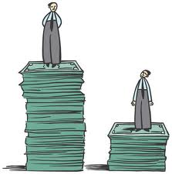
Ultimatum game experiment
Subjects perform real effort task prior to lab experiment at home
Subjects earn different amounts of money in knowledge quiz contingent on their preparatory work
Allocation to groups of two with joint account
Bargaining over distribution of joint earnings
Proposer makes offer; if responder rejects both earn nothing
Measuring normative principles
Contribution of responder
Offer to responder

Slide 23
how strong?
which principle?

Slide 24
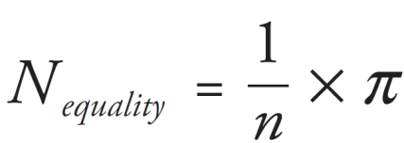
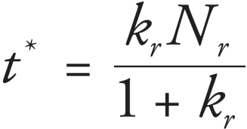
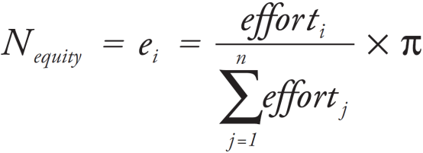
Game theoretical analysis
Utility of player i of shared pie $x∈\left[0,π\right]$ as function of
material outcome $x$
normative content $N_{i}$
normative commitment $k_{i}≥0$
Equality norm (Fehr & Schmidt 1999 )
responder’s accept- ance threshold
Equity norm (Adams 1965)
Same normative contents
Different normative contents
Critical threshold $θ$of relative effort, above which higher utility from rejection
Equity proposer with high effort will not agree to split equally
Equality proposer with little effort will not agree to offer only her effort level
For common knowledge, mutually acceptable offers always possible ($x≥t^{∗}$)
Hypothesis: More conflicts over contents than commitments

Slide 25
Estimation methods
Estimation of types by regressions for each individual’s offers and response thresholds (strategy method)
Classification of types by kernel densitites of regression parameters
Computation of all possible N = 4’830 proposer-responder combinations
Logistic regression for probability of rejection by adhering to same or different norm; robust s.e. for individuals
More conflicts over contents than commitments (z = 5.14, p < 0.001)
Normative conflicts richer research paradigm than selfishness vs. norms
Inequality (i.e. in efforts) driving force of normative conflicts

Slide 26
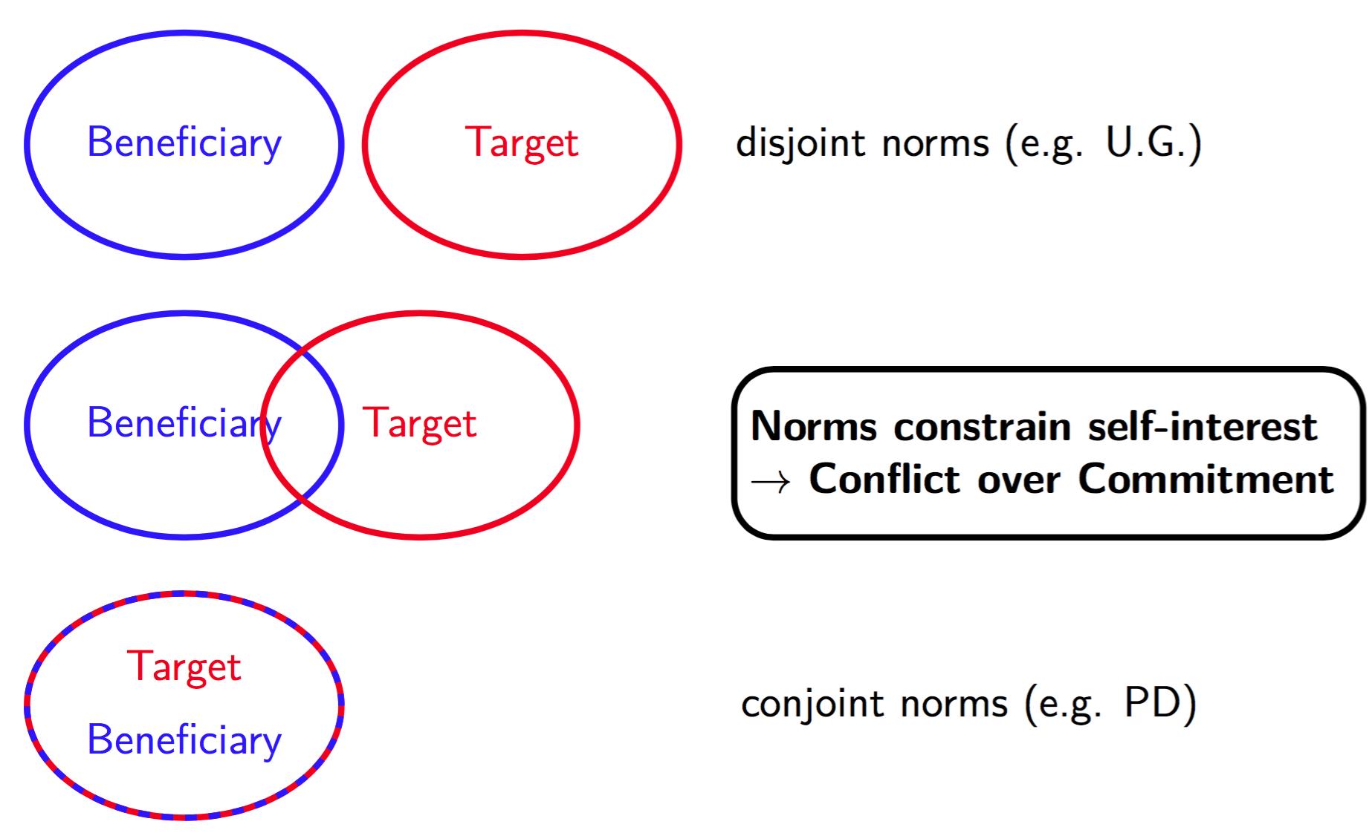
A typology of normative conflicts
Structural conflicts
Rauhut & Winter 2017: Types of Normative Conflicts and the Effectiveness of Punishment. In: Jann, Ben & Przepiorka, Wojtek: Social dilemmas, institutions, and the evolution of cooperation. De Gruyter.

Slide 27
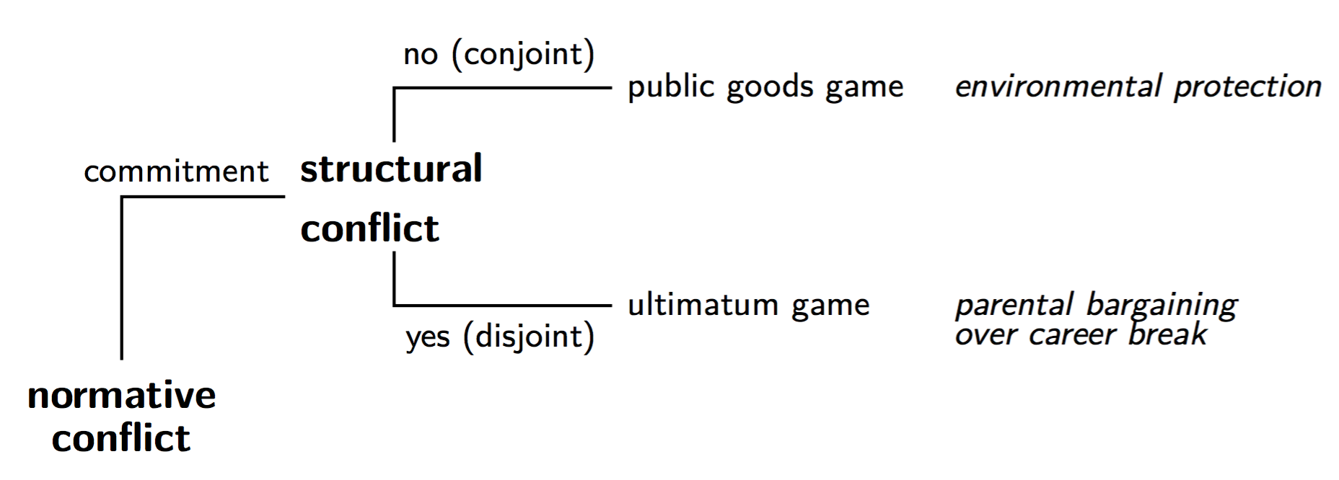
A typology of normative conflicts
Structural conflicts

Slide 28
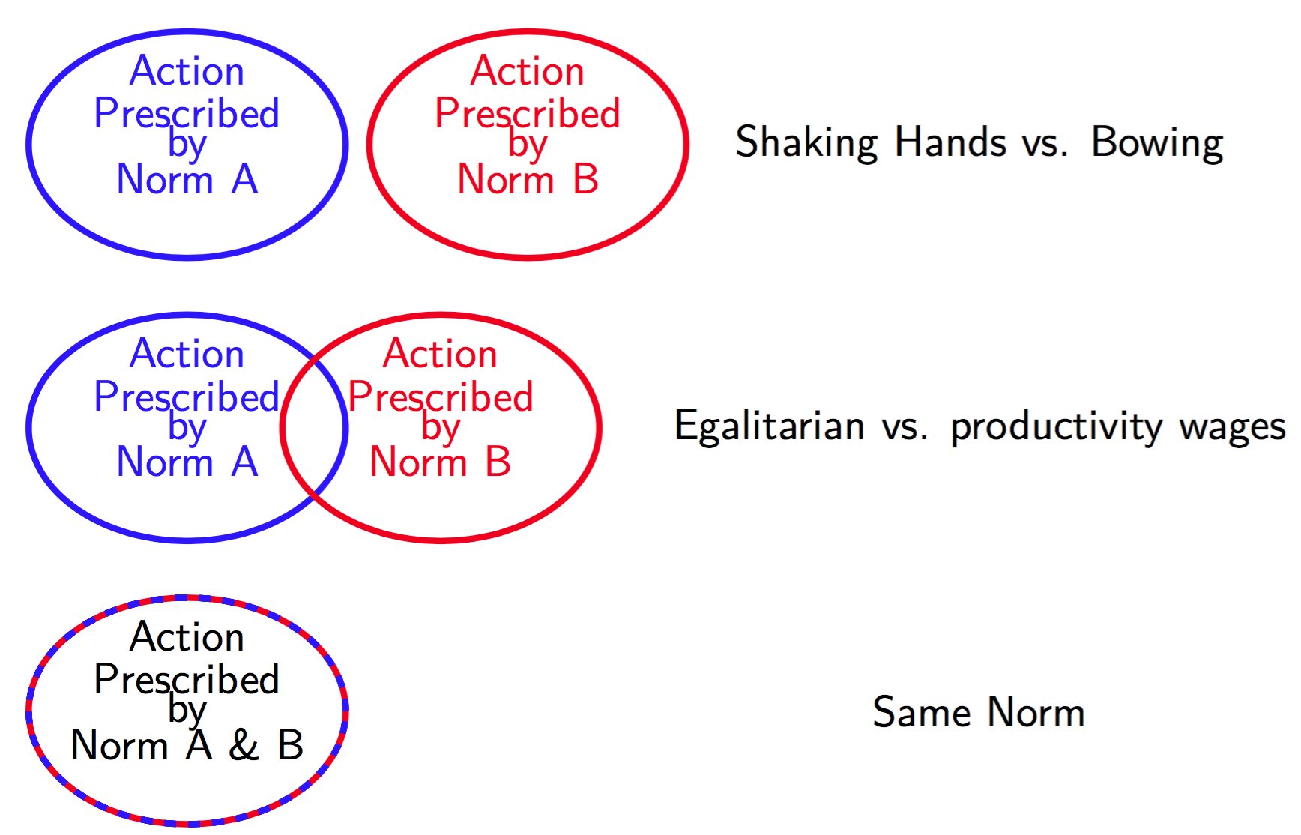
A typology of normative conflicts
Conflict over contents of a norm

Slide 29
A typology of normative conflicts
Conflict over contents of a norm

Slide 30
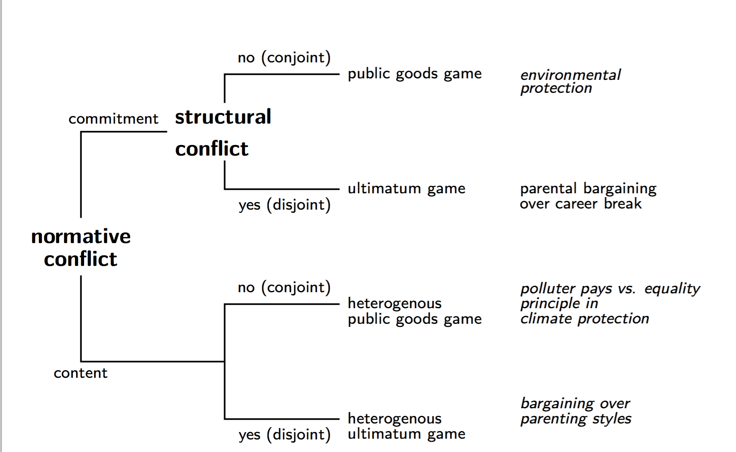
A typology of normative conflicts
Typology of normative conflict

Slide 31
A typology of normative conflicts
Typology of normative conflict

Slide 32
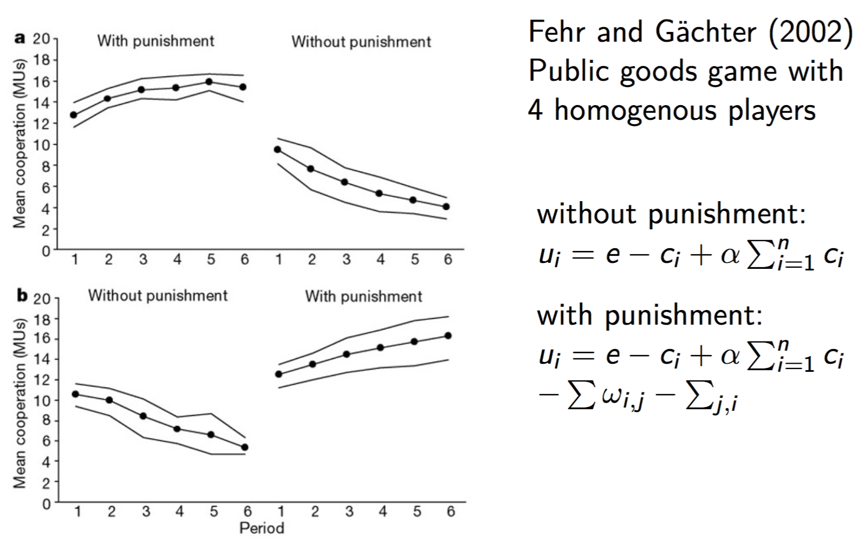
A typology of normative conflicts
No normative and no structural conflicts: punishment leads to cooperation

Slide 33
A typology of normative conflicts
Conflicts over contents in asymmeric public good game: punishment less effective

Slide 34
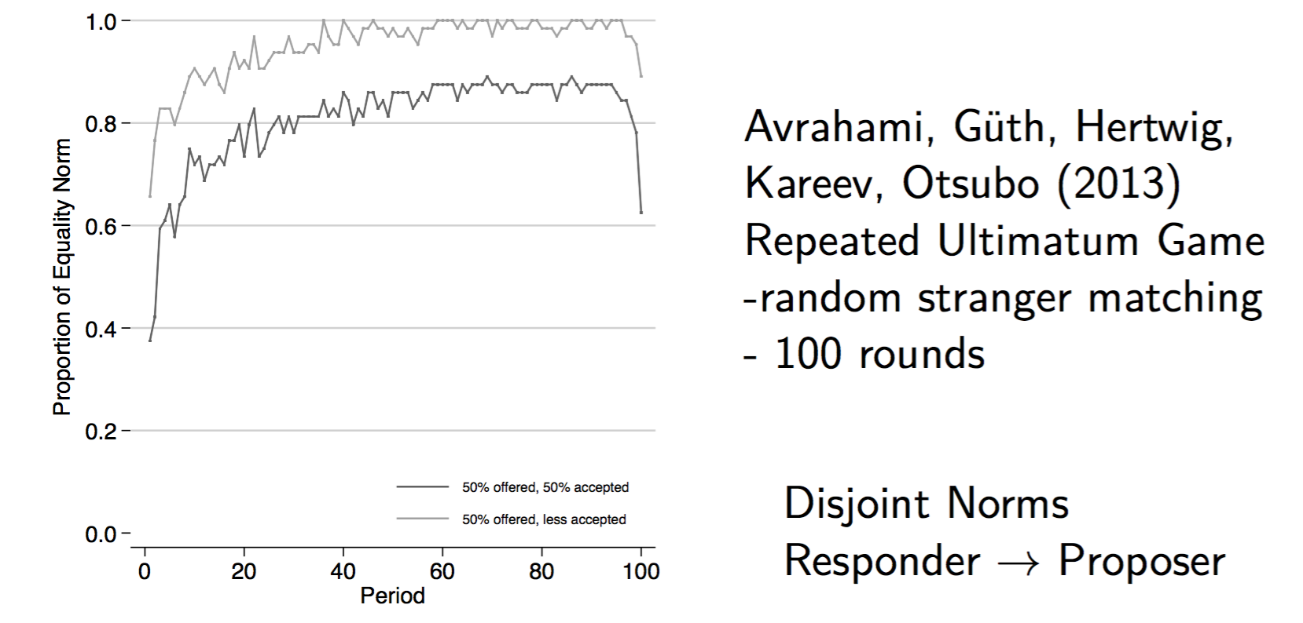
A typology of normative conflicts
structural conflicts: ultimatum game bargaining leads to 50:50 norm

Slide 35
A typology of normative conflicts
structural and content conflicts in ultimatum game with efforts: large extent of rejections

Slide 36
Group work
Pro- and contra debate
Equality Norm: People in a working unit of an organization should get equal wages
Equity : People in a working unit of an organization should get wages according to their efforts
Discuss 10 minutes in your group, work out a pleading and elect a speaker
Do a 2 minute speech in favor of your norm
Discuss your opponents arguments for 5 minutes and prepare a counter-speech
Speaker does a 1 minute counter speech
Work individually to determine your personal norm
Vote in favor of the equality or equity norm
Alternatively: Come up with own example of normative conflict and do a pro- and counter speech
Notes:
Takes about 30 minutes

