Slide 1
Cooperation and punishment
Class experiment and discussion
Prof. Dr. Heiko Rauhut
University of Zurich, Institute of Sociology
10.3.2020

Slide 2
Individual work
  Define a collective good
  Inasmuch are collective goods and prisoner’s dilemmas comparable?
  Based on the knowledge from the lecture, what would homo oeconomicus do?
  What would you expect in real life?
Notes:
Why would a pool consisting only of rational and selfish individuals do not contribute to collective goods although everybody has an interest that the collective good will be provided?

Slide 3
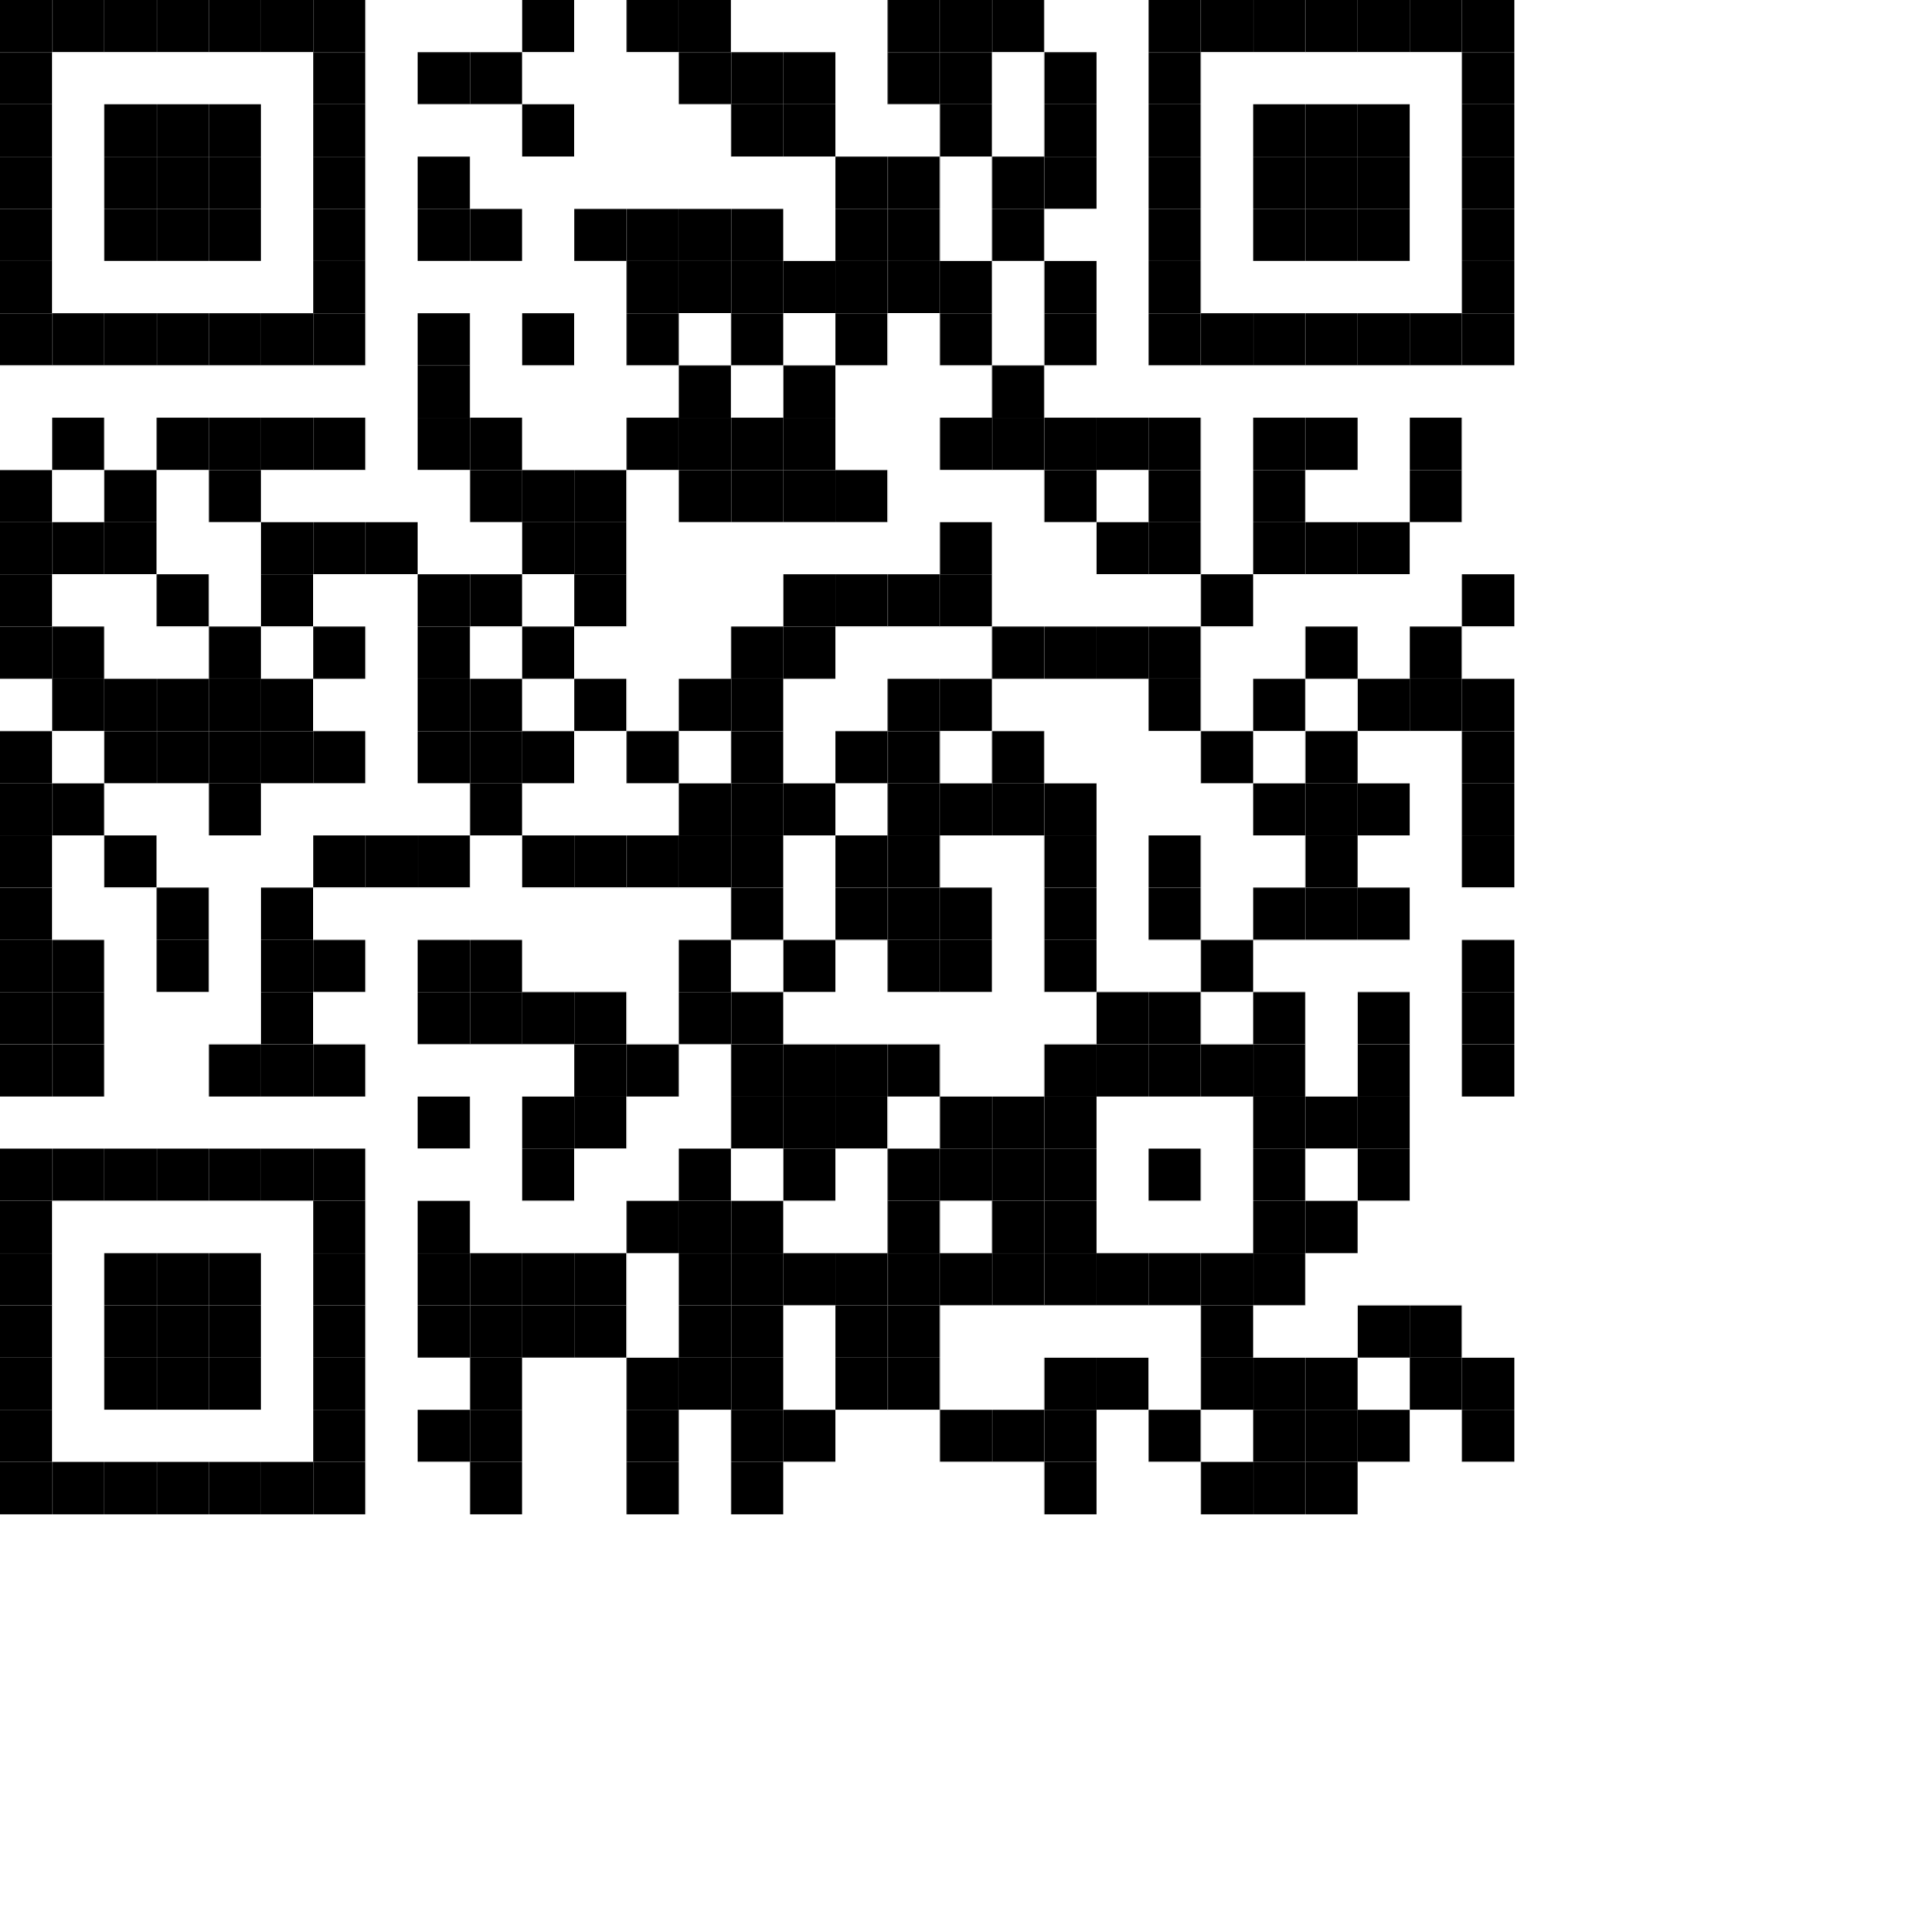
Please join the experiment!
  Or: rebrand.ly/try
Notes:
Admin:
https://suz-lab.herokuapp.com
Apple: take a picture (or via app)
Heute: PGG_Standard_Reward&Punishment

Slide 4
And now something completely different...
  Rebrand.ly/modelingfs20

Slide 5
Open group discussion
  What are your experiences?
  What is the effect of rewards (treatment: increasing points)? What is the effect of punishment (treatment: decreasing points)?
  What is the difference between your experiences and game theory classes you had before?

Slide 6
What are your own real-life examples?
  Individual work (think about some minutes)
  Describe own situations when you have cooperated!
  Why did you cooperate?

Slide 7
What are your own real-life examples?
  Individual work (think about some minutes)
  And now think about when you have not cooperated!
  What do you think would have to change so that you would have cooperated in the past or will cooperate in the future in such situations?

Slide 8
  Group 1
  Find 3 examples of collective goods!
    What would rational and selfish actors do? Discuss how people typically behave in these situations (based on your experience)
  Group 2
  Find 3 examples of punishment as an enforcing device of collective good provisions
    How is punishment implemented (e.g. avoidance, third-party or coercion)? In which ways is it costly to punish and how costly is it? Is there typically a second-order free-riding problem?
  Group 3
  Find 3 examples of rewards as an enforcing device of collective good provisions
    How are rewards implemented? In which ways are rewards costly? Is there typically a second-order free-riding problem?
Notes:
What are other mechanisms? Shame and prestige in terms of showing pictures of high and low ocntributors
Andreoni
*Samek, A. S., & Sheremeta, R. M. (2014). “Recognizing contributors: an experiment on public goods.” Experimental Economics, 17(4), 673-690. [Shame or prestige]
Andreoni, J., & Petrie, R. (2004). “Public goods experiments without confidentiality: a glimpse into fund-raising.” Journal of public Economics, 88(7-8), 1605-1623. [Social information]

Slide 9
Think about other mechanisms
  We have seen the effects of punishment and reward on cooperation…
  Can you think about other mechanisms generating cooperation?

Slide 10
  Discussion:
  What are mechanisms for the emergence and decay of cooperation?
Notes:
What are other mechanisms? Shame and prestige in terms of showing pictures of high and low ocntributors
Andreoni
*Samek, A. S., & Sheremeta, R. M. (2014). “Recognizing contributors: an experiment on public goods.” Experimental Economics, 17(4), 673-690. [Shame or prestige]
Andreoni, J., & Petrie, R. (2004). “Public goods experiments without confidentiality: a glimpse into fund-raising.” Journal of public Economics, 88(7-8), 1605-1623. [Social information]

Slide 11
Results I: Decay of cooperation
Notes:
What are other mechanisms? Shame and prestige in terms of showing pictures of high and low ocntributors
Andreoni
*Samek, A. S., & Sheremeta, R. M. (2014). “Recognizing contributors: an experiment on public goods.” Experimental Economics, 17(4), 673-690. [Shame or prestige]
Andreoni, J., & Petrie, R. (2004). “Public goods experiments without confidentiality: a glimpse into fund-raising.” Journal of public Economics, 88(7-8), 1605-1623. [Social information]

Slide 12
Results II: Proximate mechanism: imperfect conditional cooperation
Notes:
What are other mechanisms? Shame and prestige in terms of showing pictures of high and low ocntributors
Andreoni
*Samek, A. S., & Sheremeta, R. M. (2014). “Recognizing contributors: an experiment on public goods.” Experimental Economics, 17(4), 673-690. [Shame or prestige]
Andreoni, J., & Petrie, R. (2004). “Public goods experiments without confidentiality: a glimpse into fund-raising.” Journal of public Economics, 88(7-8), 1605-1623. [Social information]

Slide 13
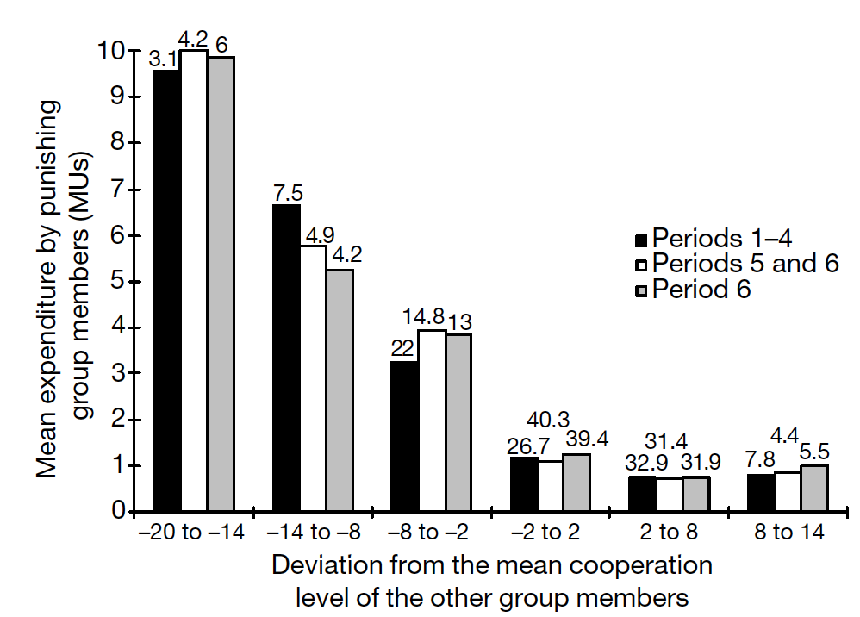
Results III: Sanctioning behavior
Fehr & Gächter (2002)
Notes:
What are other mechanisms? Shame and prestige in terms of showing pictures of high and low ocntributors
Andreoni
*Samek, A. S., & Sheremeta, R. M. (2014). “Recognizing contributors: an experiment on public goods.” Experimental Economics, 17(4), 673-690. [Shame or prestige]
Andreoni, J., & Petrie, R. (2004). “Public goods experiments without confidentiality: a glimpse into fund-raising.” Journal of public Economics, 88(7-8), 1605-1623. [Social information]

Slide 14
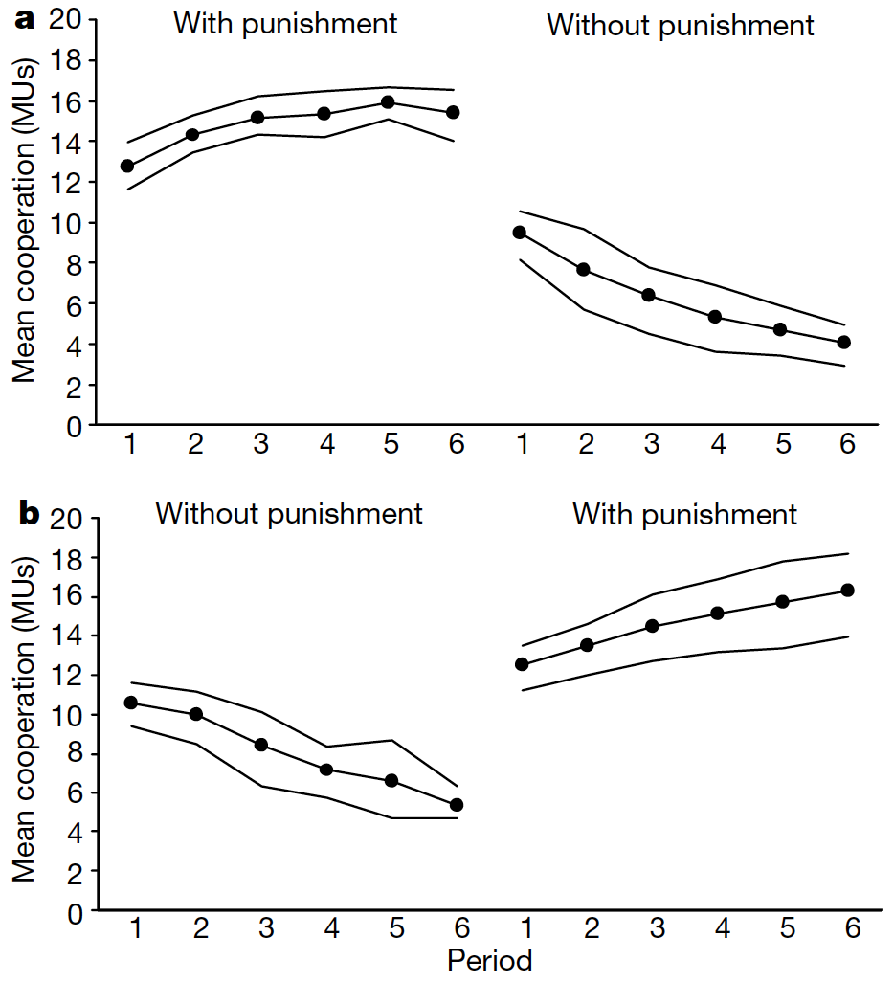
Results IV:
Effects of sanctions
Fehr & Gächter (2002)
Notes:
What are other mechanisms? Shame and prestige in terms of showing pictures of high and low ocntributors
Andreoni
*Samek, A. S., & Sheremeta, R. M. (2014). “Recognizing contributors: an experiment on public goods.” Experimental Economics, 17(4), 673-690. [Shame or prestige]
Andreoni, J., & Petrie, R. (2004). “Public goods experiments without confidentiality: a glimpse into fund-raising.” Journal of public Economics, 88(7-8), 1605-1623. [Social information]

Slide 15
  One lesson learnt:
  Small group of players (minority) with social preferences can have large consequences for macro-outcomes and large groups
Fehr & Gächter (2002)
Notes:
What are other mechanisms? Shame and prestige in terms of showing pictures of high and low ocntributors
Andreoni
*Samek, A. S., & Sheremeta, R. M. (2014). “Recognizing contributors: an experiment on public goods.” Experimental Economics, 17(4), 673-690. [Shame or prestige]
Andreoni, J., & Petrie, R. (2004). “Public goods experiments without confidentiality: a glimpse into fund-raising.” Journal of public Economics, 88(7-8), 1605-1623. [Social information]

Slide 16
Results V: Aversion from shame more powerful motivator than anticipation of prestige
Notes:
What are other mechanisms? Shame and prestige in terms of showing pictures of high and low ocntributors
Andreoni
*Samek, A. S., & Sheremeta, R. M. (2014). “Recognizing contributors: an experiment on public goods.” Experimental Economics, 17(4), 673-690. [Shame or prestige]
Andreoni, J., & Petrie, R. (2004). “Public goods experiments without confidentiality: a glimpse into fund-raising.” Journal of public Economics, 88(7-8), 1605-1623. [Social information]

Slide 17
Results V: Aversion from shame more powerful motivator than anticipation of prestige
Notes:
What are other mechanisms? Shame and prestige in terms of showing pictures of high and low contributors
Andreoni *Samek, A. S., & Sheremeta, R. M. (2014). “Recognizing contributors: an experiment on public goods.” Experimental Economics, 17(4), 673-690. [Shame or prestige]
Andreoni, J., & Petrie, R. (2004). “Public goods experiments without confidentiality: a glimpse into fund-raising.” Journal of public Economics, 88(7-8), 1605-1623. [Social information]

Slide 18
Results V: Aversion from shame more powerful motivator than anticipation of prestige
Samek, A. S., & Sheremeta, R. M. (2014). “Recognizing contributors: an experiment on public goods.” Experimental Economics, 17(4), 673-690.
Notes:
What are other mechanisms? Shame and prestige in terms of showing pictures of high and low ocntributors
Andreoni
*Samek, A. S., & Sheremeta, R. M. (2014). “Recognizing contributors: an experiment on public goods.” Experimental Economics, 17(4), 673-690. [Shame or prestige]
Andreoni, J., & Petrie, R. (2004). “Public goods experiments without confidentiality: a glimpse into fund-raising.” Journal of public Economics, 88(7-8), 1605-1623. [Social information]

Slide 19
Results V: Aversion from shame more powerful motivator than anticipation of prestige
Samek, A. S., & Sheremeta, R. M. (2014). “Recognizing contributors: an experiment on public goods.” Experimental Economics, 17(4), 673-690.
Notes:
What are other mechanisms? Shame and prestige in terms of showing pictures of high and low ocntributors
Andreoni
*Samek, A. S., & Sheremeta, R. M. (2014). “Recognizing contributors: an experiment on public goods.” Experimental Economics, 17(4), 673-690. [Shame or prestige]
Andreoni, J., & Petrie, R. (2004). “Public goods experiments without confidentiality: a glimpse into fund-raising.” Journal of public Economics, 88(7-8), 1605-1623. [Social information]

